Slide 1
MATH1123
Calculus for Science and Engineering

Slide 2
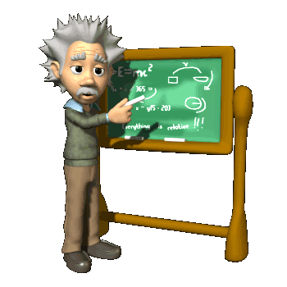
Chapter 1
Limits and Continuity (极限和连续)
In this Chapter, we will know some important concepts.
Limits (极限)
Continuity (连续)
Limits Involving Infinity (与无穷有关的极限)

Slide 3
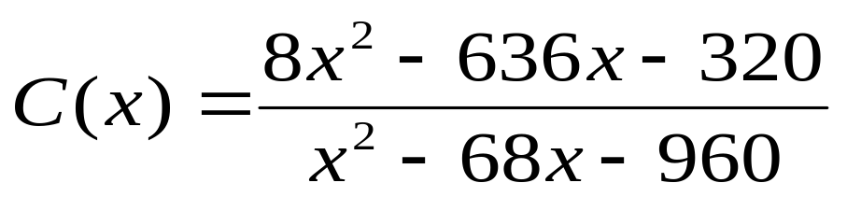
Section 1.1 The Concept Of Limit
To illustrate the limit process, consider a manager who determines that when x percent of her company’s plant capacity is being used, the total cost is
hundred thousand dollars. The company has a policy of rotating maintenance in such a way that no more than 80% of capacity is ever in use at any one time. What cost should the manager expect when the plant is operating at full permissible capacity?

Slide 4
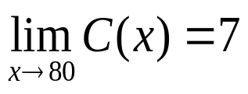
It may seem that we can answer this question by simply evaluating C(80), but attempting this evaluation results in the meaningless fraction 0/0. However, it is still possible to evaluate C(x) for values of x that approach 80 from the left (x<80) and the right (x>80), as indicated in this table:
x approaches 80 from the left → ←x approaches 80 from the right
x | 79.8 | 79.99 | 79.999 | 80 | 80.0001 | 80.001 | 80.04
C(x) | 6.99782 | 6.99989 | 6.99999 |  | 7.000001 | 7.00001 | 7.00043
The values of C(x) displayed on the lower line of this table suggest that C(x) approaches the number 7 as x gets closer and closer to 80. The functional behavior in this example can be describe by

Slide 5
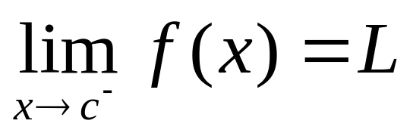
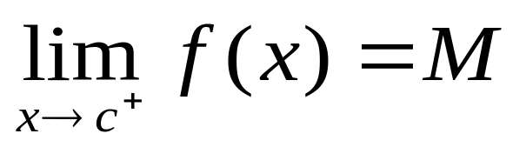
If f(x) approaches L as x tends toward c from the left (x<c), we write
where L is called the limit from the left (or left-hand limit)
Likewise if f(x) approaches M as x tends toward c from the right (x>c), then
M is called the limit from the right (or right-hand limit.)

Slide 6
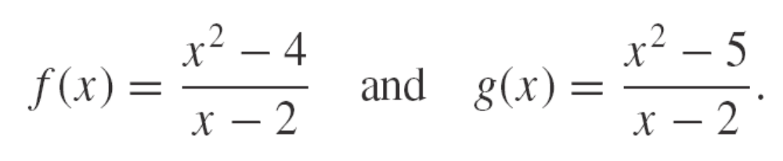
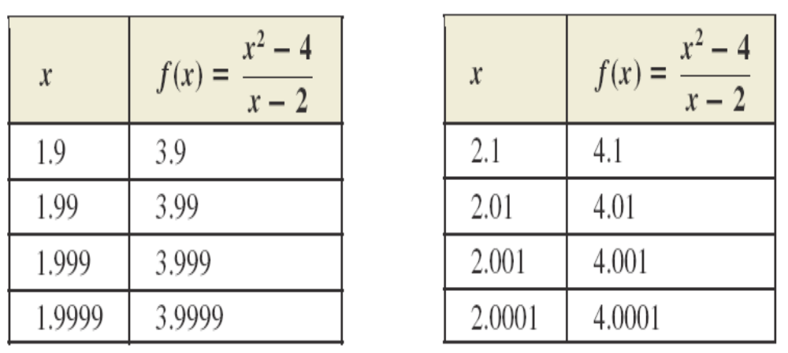
As a start, we consider the functions
For first function f(x), we compute some values of
the function for x close to 2, as in the following
tables.

Slide 7
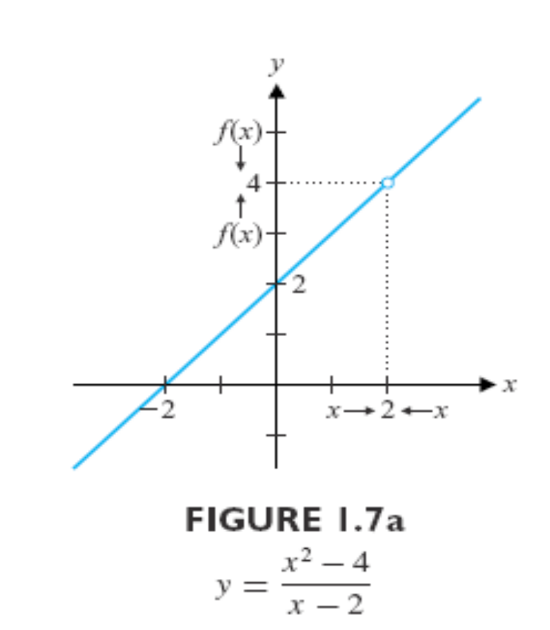
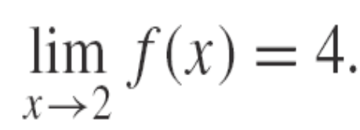
Notice that the table and the graph both suggest that as x approaches 2 from two sides (left side and right side), f(x) gets closer and closer to 4, written
It is important to remember that limits describe the behavior of a function near a particular point, not necessarily at the point itself.

Slide 8
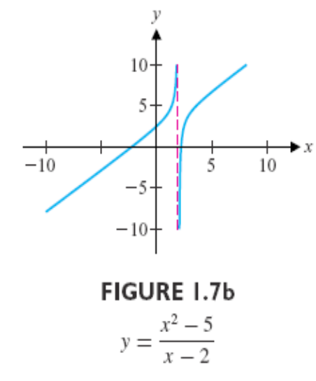
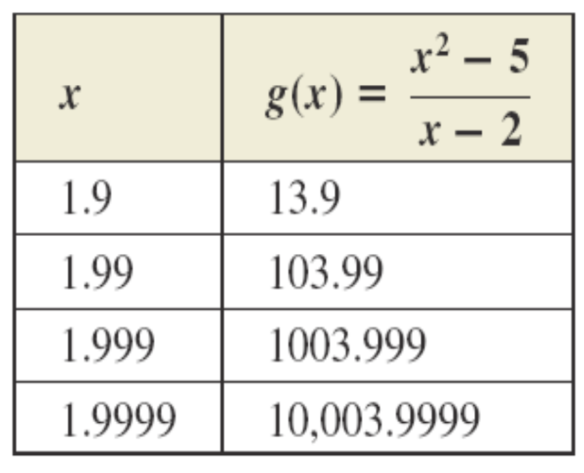
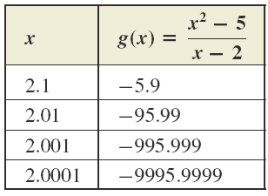
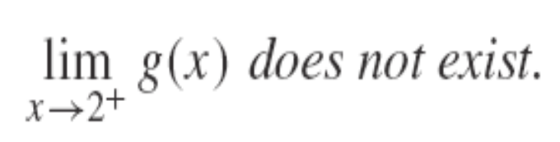
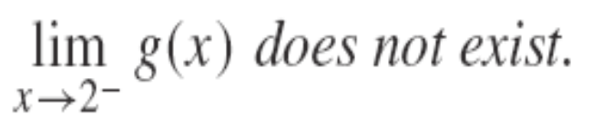
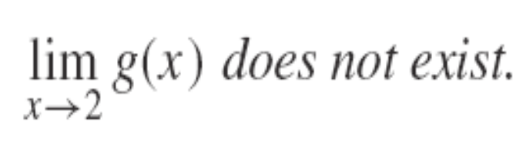
For the second function g(x), we have following tables and figures
Since neither limit exists, we say that the limit of g(x) as x approaches 2 does not exist, written

Slide 9
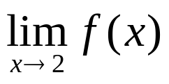
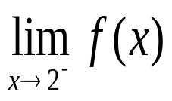
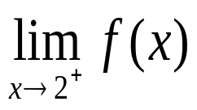
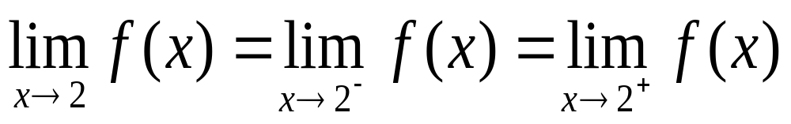
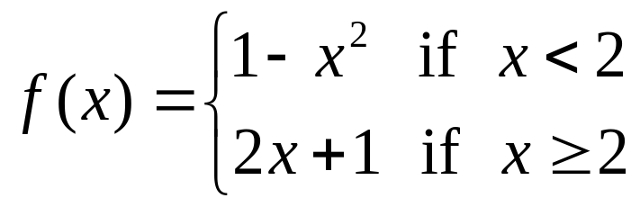

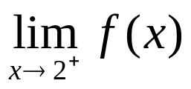
Existence of a Limit: The two-sided limit exists if and only if the two one-sided limits and exist and are equal, and then
For the function
evaluate the one-sided limits and

Slide 10
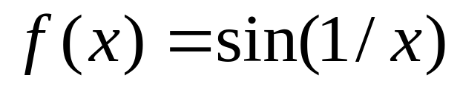
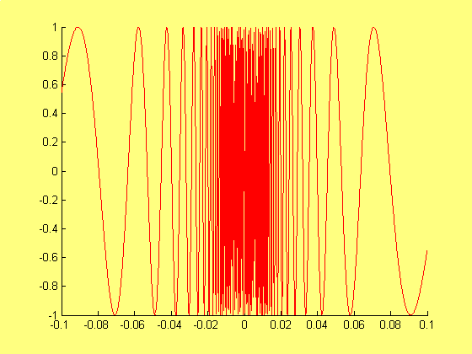
Nonexistent One-sided Limits
A simple example is provided by the function
As x approaches 0 from either the left or the right, f(x) oscillates between -1 and 1 infinitely often. Thus neither one-sided limit at 0 exists.

Slide 11
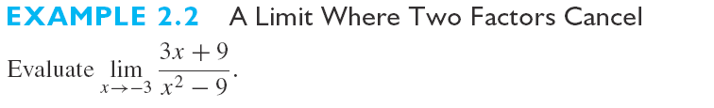
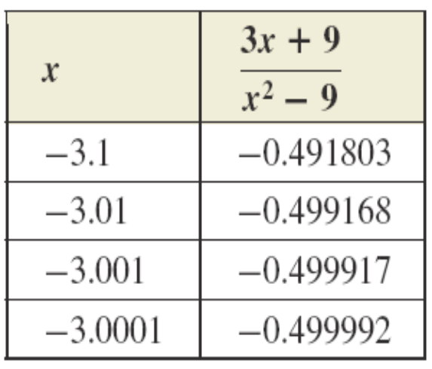
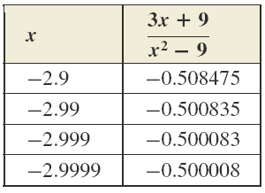
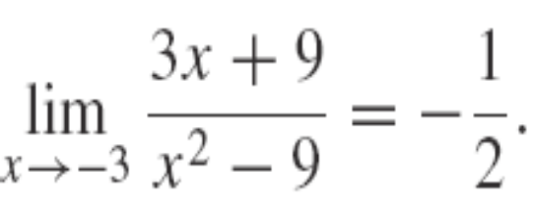
Since the function approaches the same value as x→-3 both from the right and from the left, we write

Slide 12
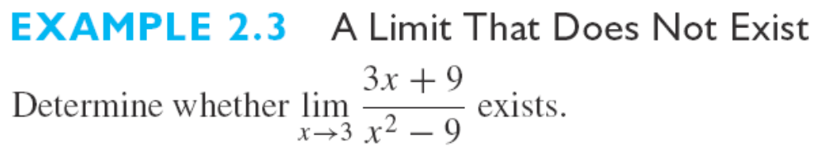
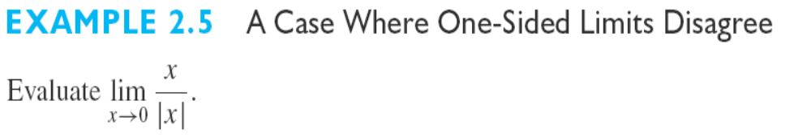
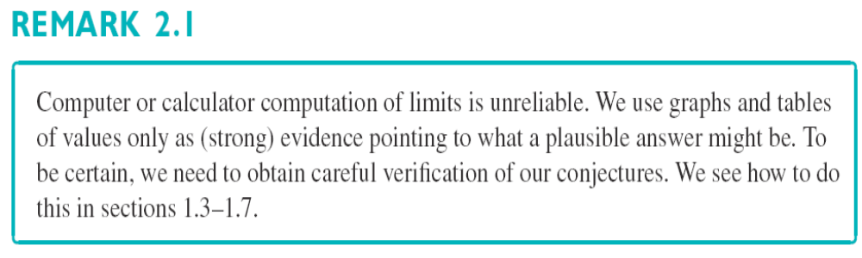

Slide 13
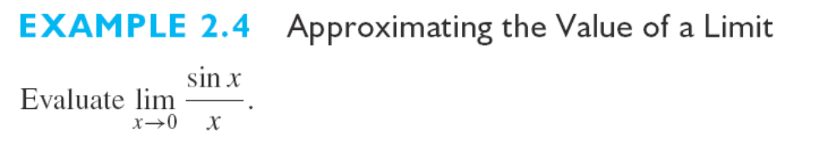
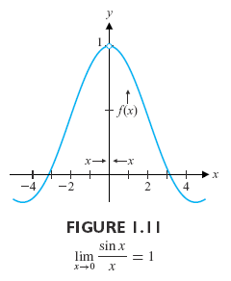
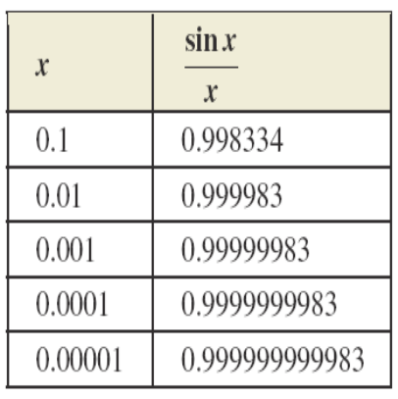
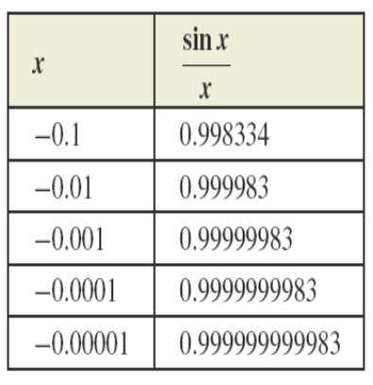
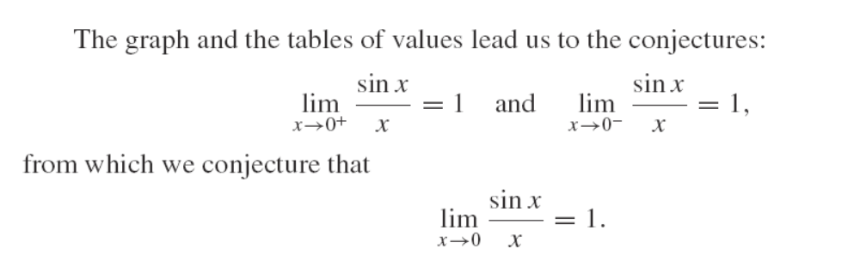

Slide 14
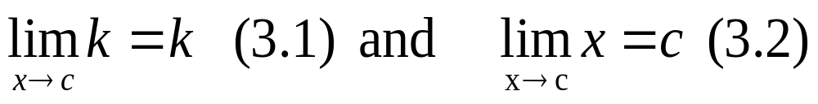
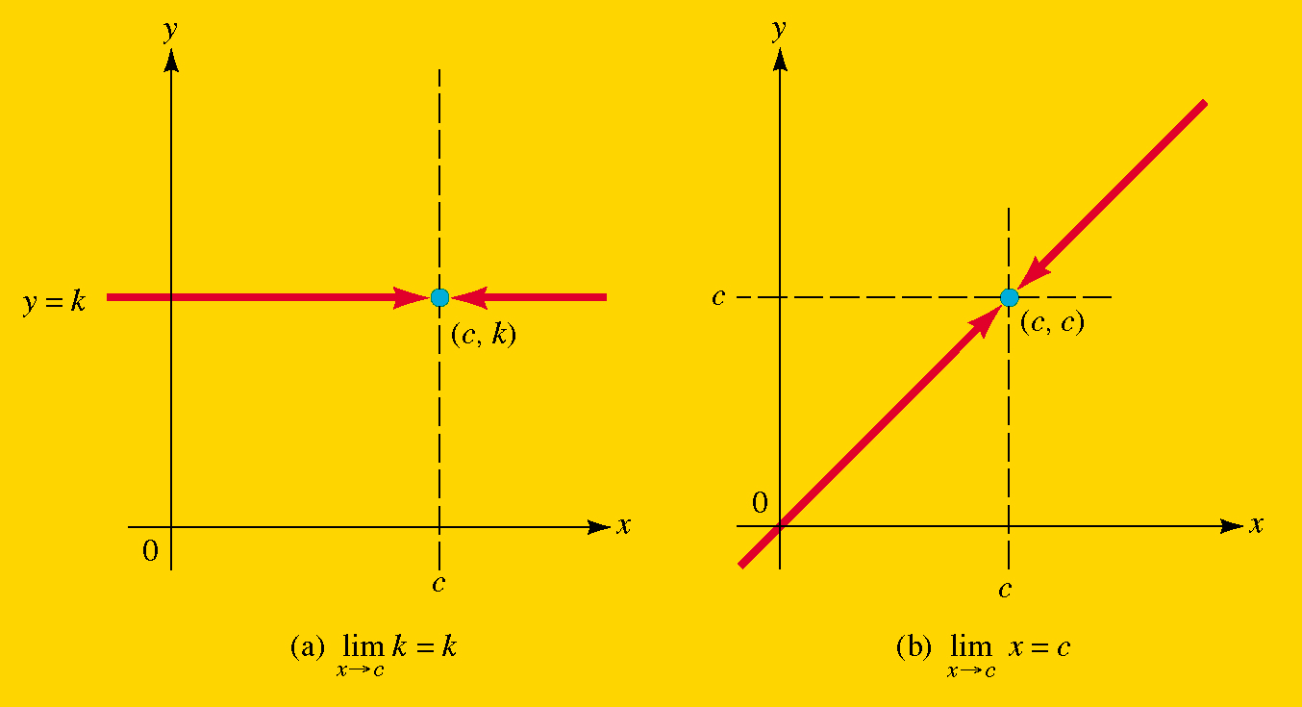
Section 1.2 Computation Of Limits
For any constant k,
That is, the limit of a constant is the constant itself, and the limit of f(x)=x as x approaches c is c.

Slide 15
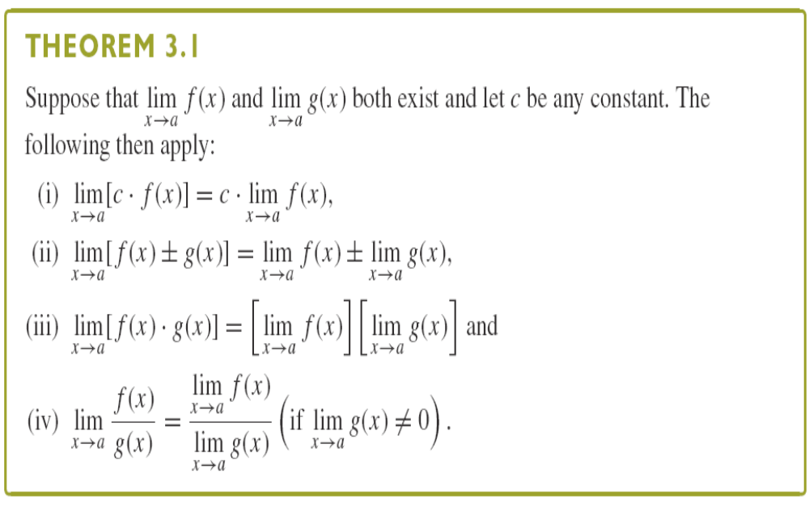

Slide 16
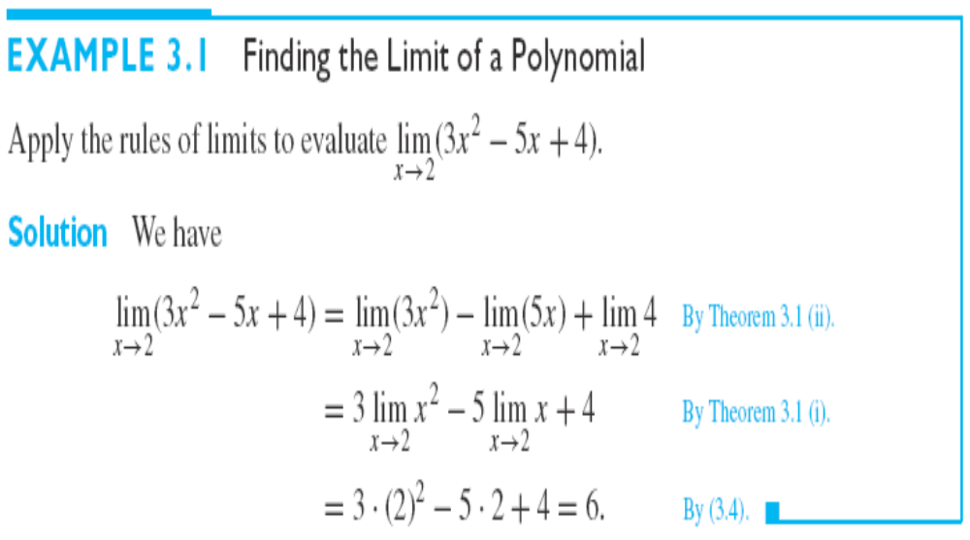

Slide 17
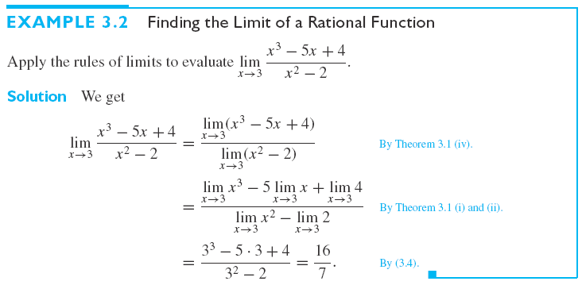

Slide 18
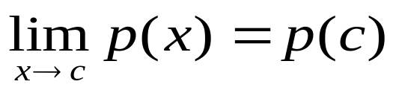
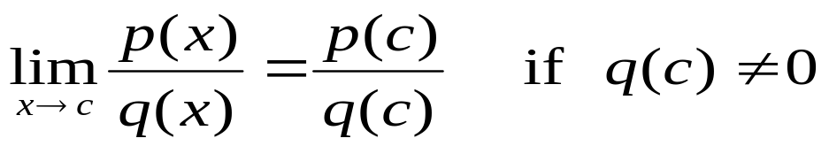
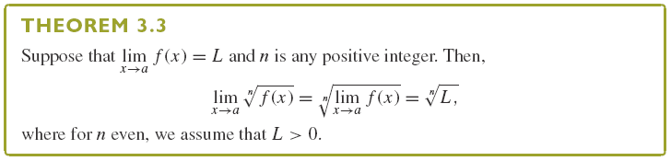
THEOREM 3.2 Limits of Polynomials and Rational Functions: If p(x) and q(x) are polynomials, then
and

Slide 19
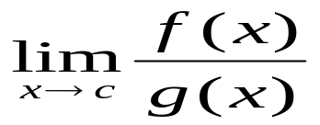
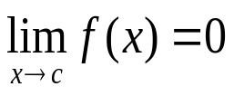

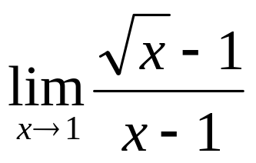
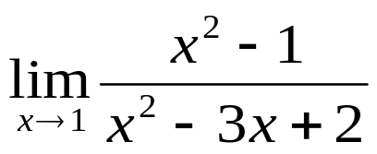
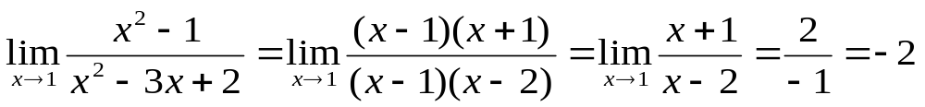
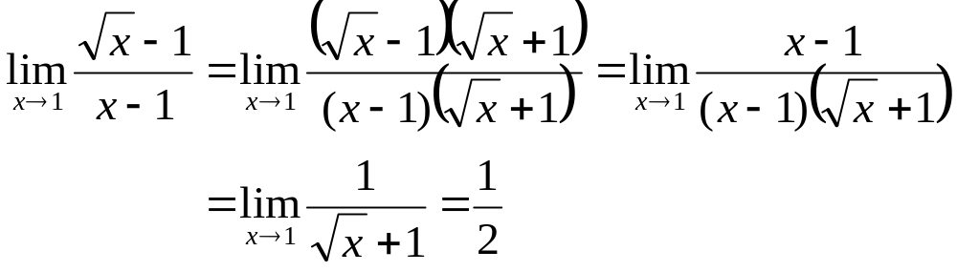
Indeterminate Form
If and , then is said to be indeterminate. The term indeterminate is used since the limit may or may not exist.
Example
Find the Limit by Factoring and Rationalizing
(a) Find (b) Find
Solution:
b.

Slide 20
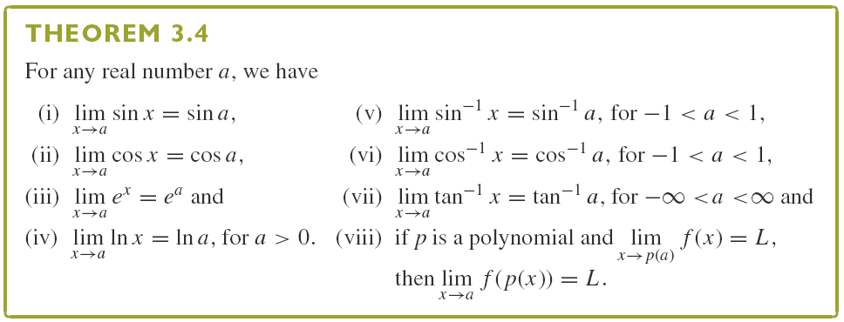


Slide 21



Idea:
Your first reaction might be to say that this is a limit of a product and it must be the product of the limits:
Since does not exist, we can not directly use Theorem 3.1.

Slide 22

Squeeze Theorem (两面夹定理)

Slide 23

The challenge in using the Squeeze Theorem is in finding appropriate functions f and h that bound a given function g from below and above, respectively, and that have the same limit as x→a.

Slide 24



Solution:
Recall that

Slide 25

Section 1.3 Continuity and Its Consequences
A continuous function is one whose graph can be drawn without the “pen” leaving the paper. (no holes or gaps )

Slide 26

A “hole “ at x=c

Slide 27

A “gap” at x=c

Slide 28



Definition 4.1
Continuity(连续): A function f is continuous at c if all
three of these conditions are satisfied:
If f(x) is not continuous at c, it is said to have a
discontinuity there.

Slide 29




Slide 30

When we can remove a discontinuity by defining the function at that point, we call the discontinuity removable.
Not all discontinuities are removable.

Slide 31


Continuity Polynomials and Rational Functions
If p(x) and q(x) are polynomials, then
A polynomial or a rational function is continuous wherever it is defined

Slide 32



Slide 33




Slide 34


Continuity on an Interval
A function f(x) is said to be continuous on an open interval a<x<b if it is continuous at each point x=c in that interval.
f is continuous on closed interval a≤x≤b, if it continuous on the open interval a<x<b and
If f is continuous on all of (-∞, ∞) , we simply say that f is continuous everywhere.

Slide 35



Example 4.8
Discuss the continuity of the function on the open interval -2<x<3 and on the closed interval -2≤x≤3

Slide 36

Theorem 4.4 The Intermediate Value Property
Suppose that f(x) is continuous on the interval a≤x≤b and L is a number between f(a) and f(b), then there exists a number c between a and b, such that f(c)=L.

Slide 37

The condition: f(x) is continuous on the closed interval [a,b], can not be relaxed.
Can you find an example?

Slide 38

In following Corollary, we see an immediate and useful application of the Intermediate Value Theorem
Corollary 4.2
If f is continuous on the closed interval [a,b], and f(a) and f(b) have opposite signs [i.e. f(a)f(b)<0], then there exists a number c in (a,b) where f(c)=0.

Slide 39
Remark:
Notice that The Intermediate Value Theorem and Corollary 4.2 are example of existence theorems; they tell you that there exists a number c satisfying some condition, but they do not tell you what c is and where c is.

Slide 40



Example
Show that the equation has a solution for
1<x<2
Solution:
Let . Then f(1)=-3/2 and f(2)=2/3. Since f(x) is continuous for 1≤x≤2, it follows from the intermediate value property that the graph must cross the x axis somewhere between x=1 and x=2.

Slide 41



The Method of Bisections (二分法)
The method of Bisections can help us locate the zeroes of a function.

Slide 42




Section 1.4 Limits Involving Infinity; Asymptotes(渐近线)
Solution: As we know, as x→0+, 1/x increases without bound, while as x→0-, 1/x decreases without bound, so we say that and do not exist. We say that

Slide 43



Slide 44




Solution: We can see that
and
Since both one-sided limits agree, we say that
This one concise statement says that the limit does not exist.

Slide 45


Slide 46




Slide 47


垂直渐近线

Slide 48




Example
Determine all vertical asymptotes of the graph of
Solution:
Let and be the numerator and denominator of f(x), respectively. The q(x)=0 when x=-3 and when x=0. However, for x=-3, we also have p(-3)=0 and
This means that the graph of f(x) has a “hole” at the point (-3,2) and x=-3 is not a vertical asymptote of the graph.
to be continued

Slide 49


On the other hand, for x=0 we have q(0)=0 but p(0)≠0, which suggests that the y axis is a vertical asymptote for the graph of f(x). This asymptote behavior is verified by noting that

Slide 50


Limits at Infinity （无穷处极限）
Limits at Infinity: If the value of the function f(x) approach the number L as x increases without bound, we write
Similarly, we write
when the functional values f(x) approach the number M as x decreases without bound.

Slide 51


水平渐近线

Slide 52



Slide 53



Example
Find
Solution:

Slide 54




Rule of Thumb （经验法则）
Procedure for Evaluating a Limit at Infinity of f(x)=p(x)/q(x)
Step 1. Divide each term in f(x) by the highest power x^{k} that appears in the denominator polynomial q(x).
Step 2. Compute or using algebraic properties of limits and the reciprocal rules.
Exercise
and

Slide 55




Example
Determine all horizontal asymptotes of the graph of
Solution:
Dividing each term in the rational function f(x) by (the highest power of x in the denominator), we find that
and similarly,
to be continued

Slide 56

Thus, the graph of f(x) has y=1 as a horizontal asymptote.
NOTE: The graph of a function f(x) can never cross a vertical asymptote x=c because at least one of the one-sided limits must be infinite. However, it is possible for a graph to cross its horizontal asymptotes.

Slide 57


Limits involving exponential functions are very important in many applications.
Inverse trigonometric functions may have horizontal asymptotes.

